Slide 1
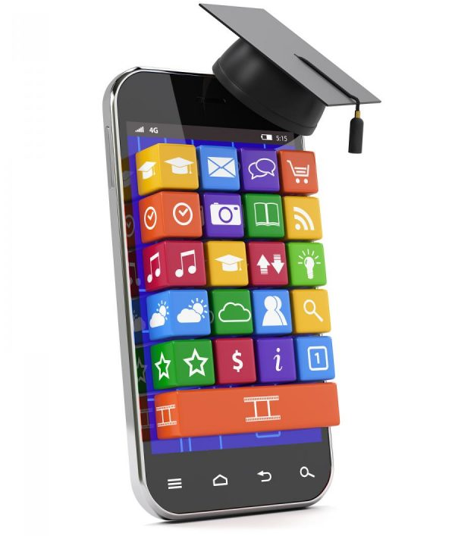
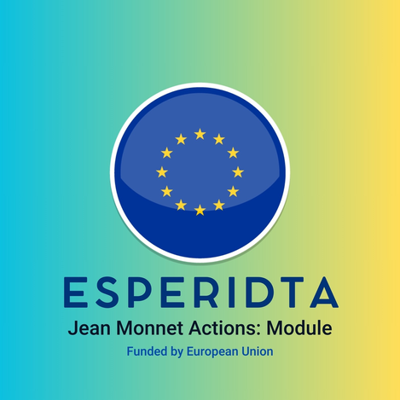

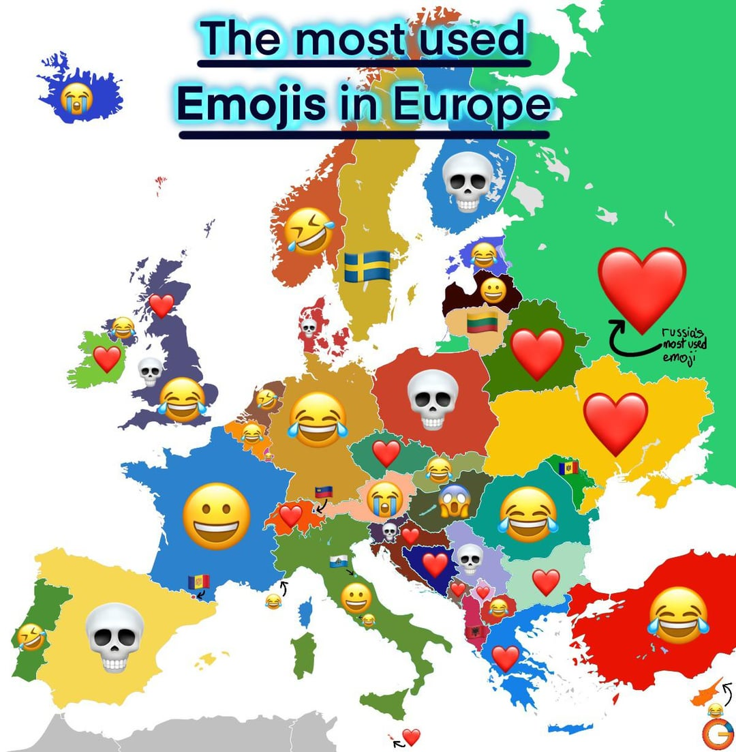
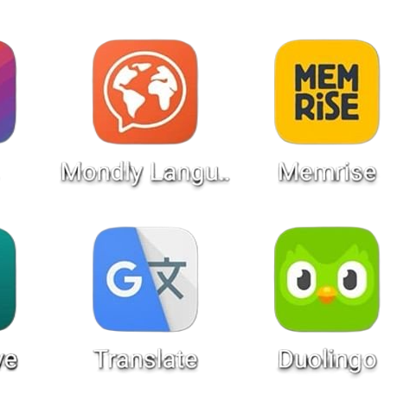
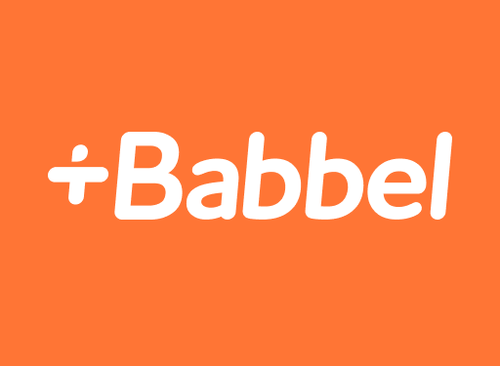
The Impact of Digital Media on Language Evolution in Europe
Balancing Pros and Cons
Presented by: Zozan Dagdeviren

Slide 2
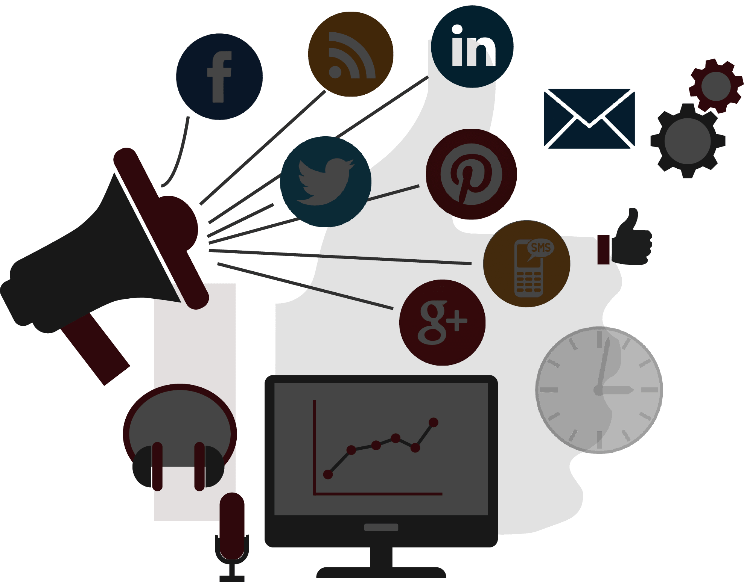
The Digital Era Language Evolution
Digital media is reshaping how people communicate and use languages.
It brings both opportunities and challenges for Europe’s linguistic diversity.

Slide 3

Pros – Simplifying Communication
Social media promotes informal expressions like slang, emojis (😊), and abbreviations (e.g., "LOL" for laughing out loud).
Multilingual Europeans mix languages in online chats (e.g., combining Polish and English).
Example: Idzemy na lunch today?

Slide 4

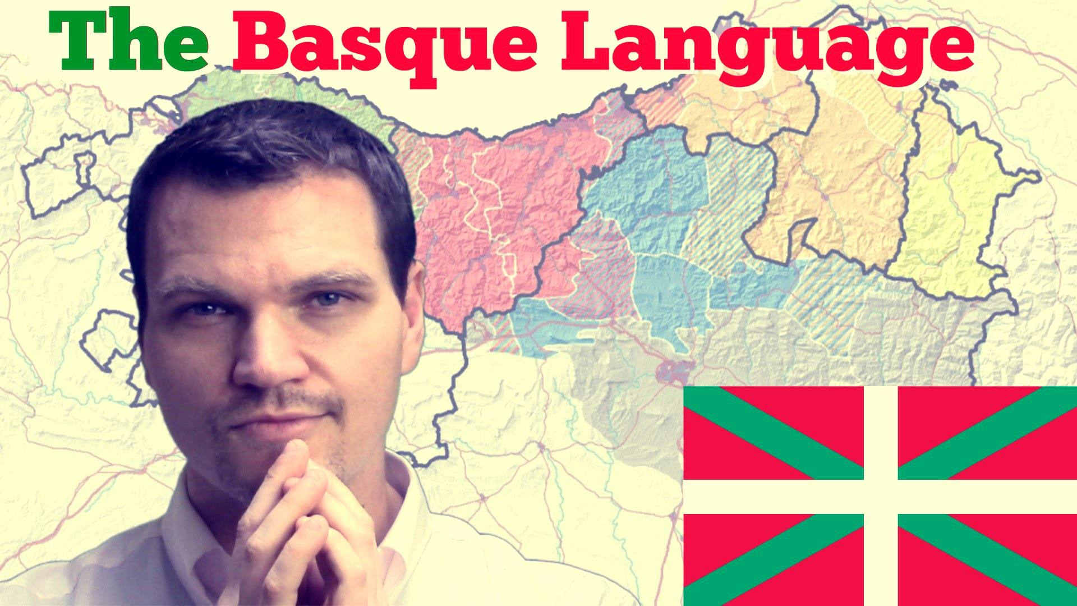
Pros – Preserving Minority Languages
Platforms like YouTube and TikTok showcase minority languages (e.g., Welsh or Basque).
Apps like SaySomethingInWelsh and Euskara Munduan help sustain language learning.

Slide 5
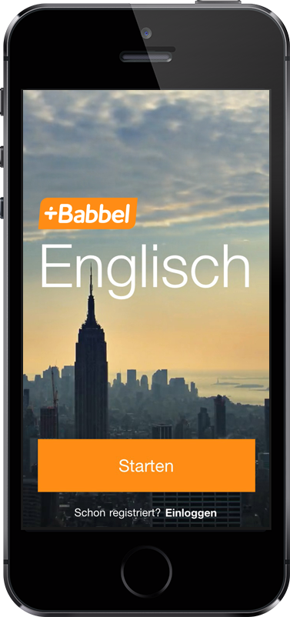
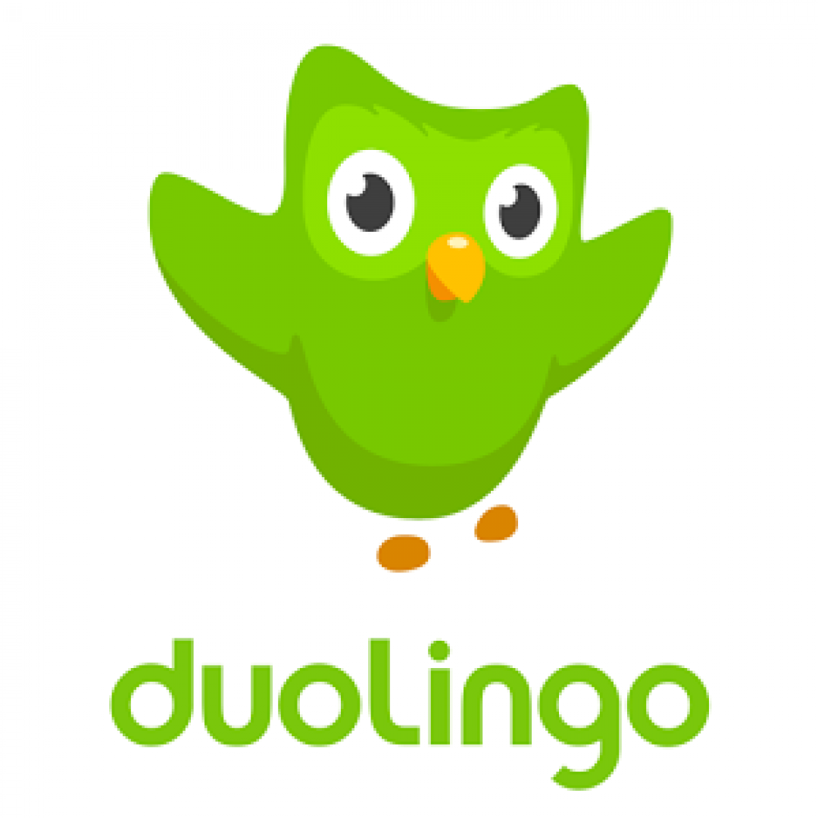
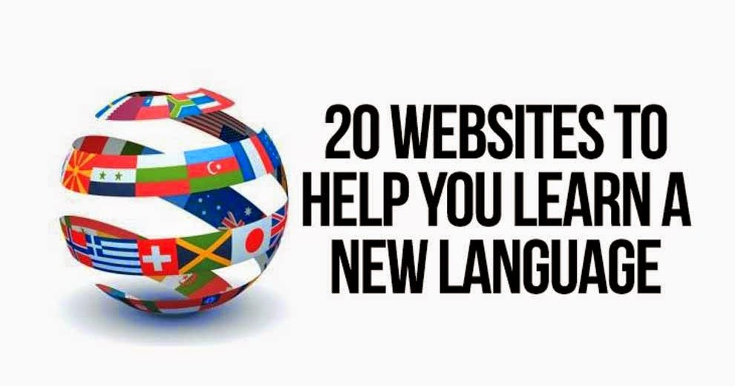
Pros – Making Language Learning Easy
Apps like Duolingo and Babbel simplify learning new languages.
Social media exposes people to different languages informally through memes and videos.

Slide 6
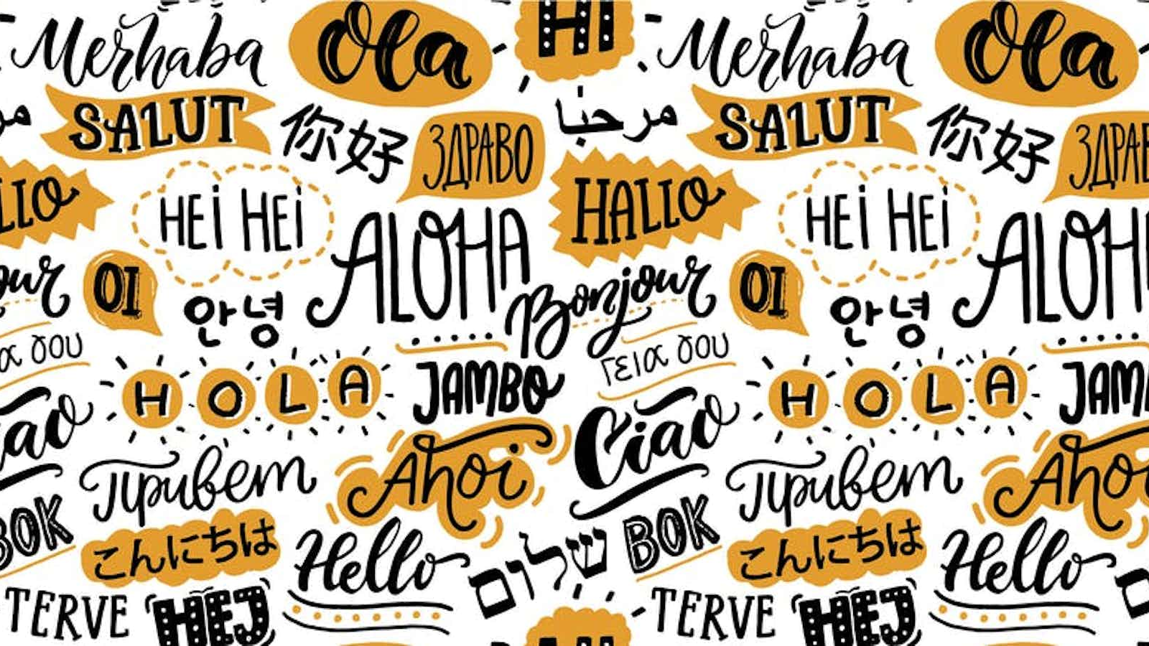
Pros – Multilingual Content Creation
Content creators using multiple languages promote cross-cultural understanding.

Slide 7
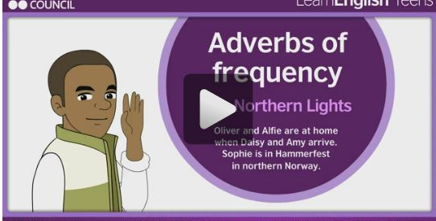
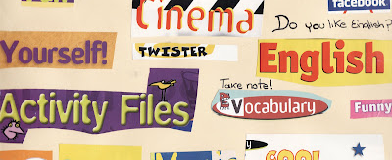
Cons – Dominance of Global Languages
English dominates online platforms, reducing the daily use of smaller languages like Breton or Sámi.

Slide 8
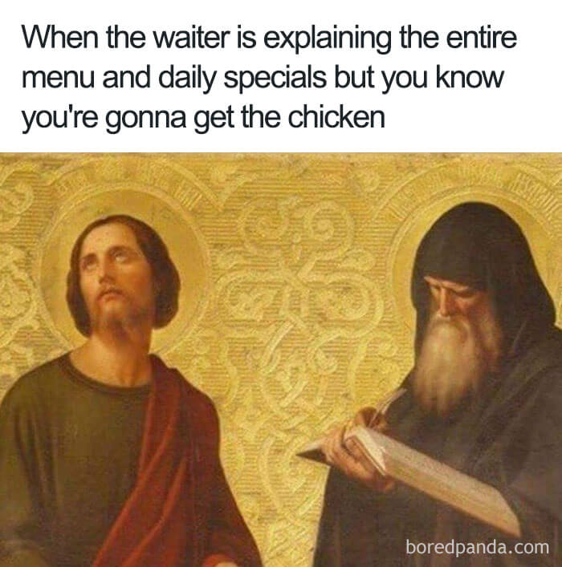
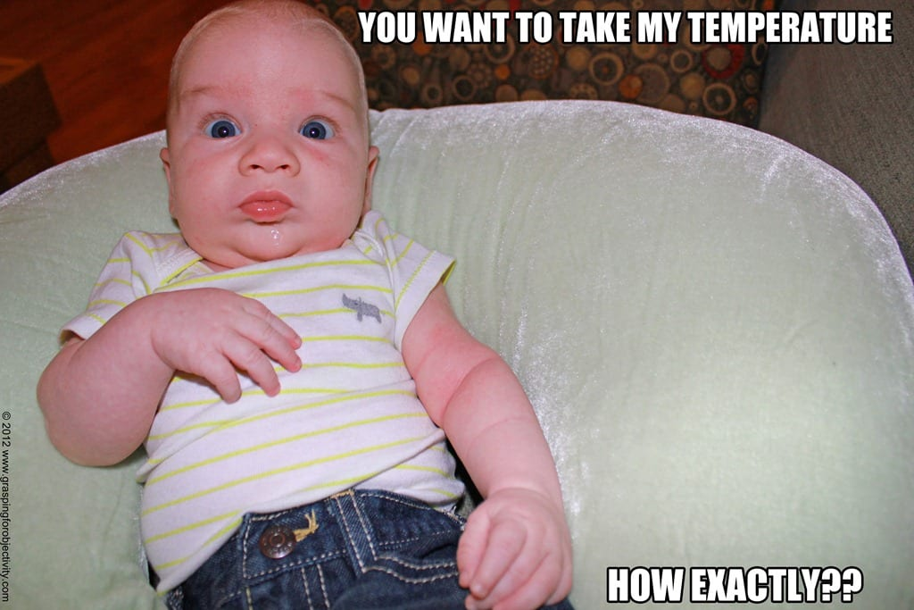
Cons – Simplification of Grammar and Style
Digital conversations often skip proper grammar and punctuation (e.g., "wru? meet tmr?").
Memes can encourage overly casual or incorrect language use.

Slide 9

Cons – Generational Gaps in Language Use
Younger people adopt digital slang and emojis (“sus,” “slay”), creating a gap with older generations.

Slide 10


Cons – Threat to Cultural Identity
The decline of regional languages threatens cultural identity and traditions.

Slide 11

Conclusion
Digital media promotes creativity and multilingualism but risks overshadowing smaller languages and formal language skills.
Efforts to preserve linguistic diversity through apps, government support, and education are crucial.

Slide 12
Call to Action
Celebrate and share minority languages online.
1
Use language-learning tools to explore diverse cultures.
2
Support digital projects that protect endangered languages.
3

