Slide 1
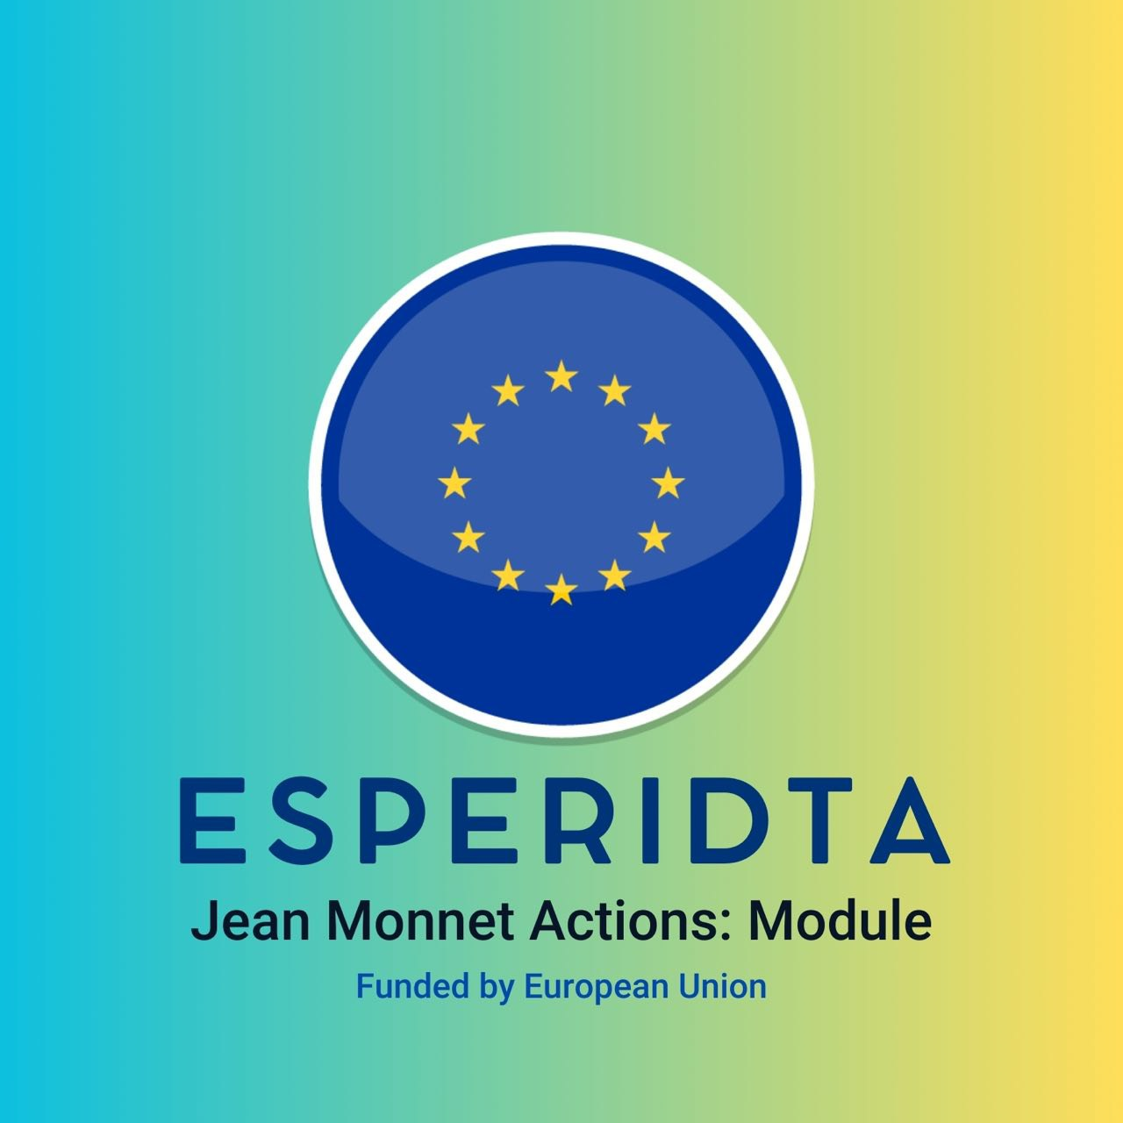
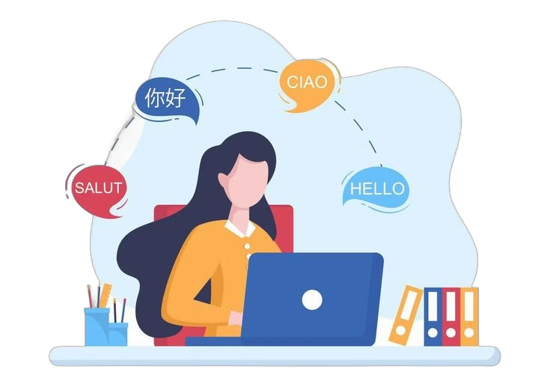
Digital Tools for Multilingual Education in European Studies
ZHANNA SULIMA, ULIANA VITKOVSKA

Slide 2
Importance of Multilingualism in European Education
Fostering Cultural Understanding
Enhancing Career Opportunities
Proficiency in multiple European languages enables deeper appreciation of diverse cultures and traditions.
Multilingual skills open doors to international employment and collaboration across the EU.
Educational Benefits
Social Inclusion and Mobility
Learning multiple languages enhances brain development, problem-solving, and critical thinking skills.
Multilingual education helps integrate migrants and refugees, ensuring social cohesion and reducing inequality.

Slide 3
Challenges in Teaching European Languages and Cultures
1
Diverse Language Backgrounds
2
Limited Classroom Time
3
Engaging Digital Natives
Students come from varied linguistic and cultural contexts, requiring personalized approaches.
Traditional language courses often struggle to provide sufficient practice and engagement.
Tech-savvy students expect innovative, interactive learning experiences.

Slide 4
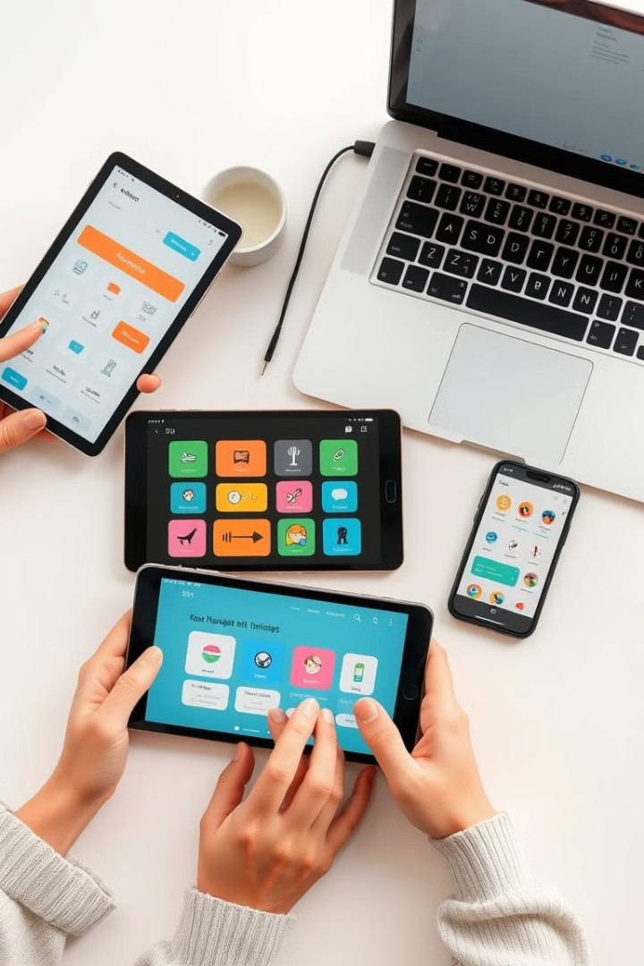
Overview of Digital Tools for Language Learning
Virtual Classrooms
Language Apps
Enabling real-time, interactive lessons with native speakers and classmates.
Providing personalized, gamified language practice on-the-go.
Online Tutorials
Offering self-paced, multimedia-rich lessons for independent study.

Slide 5
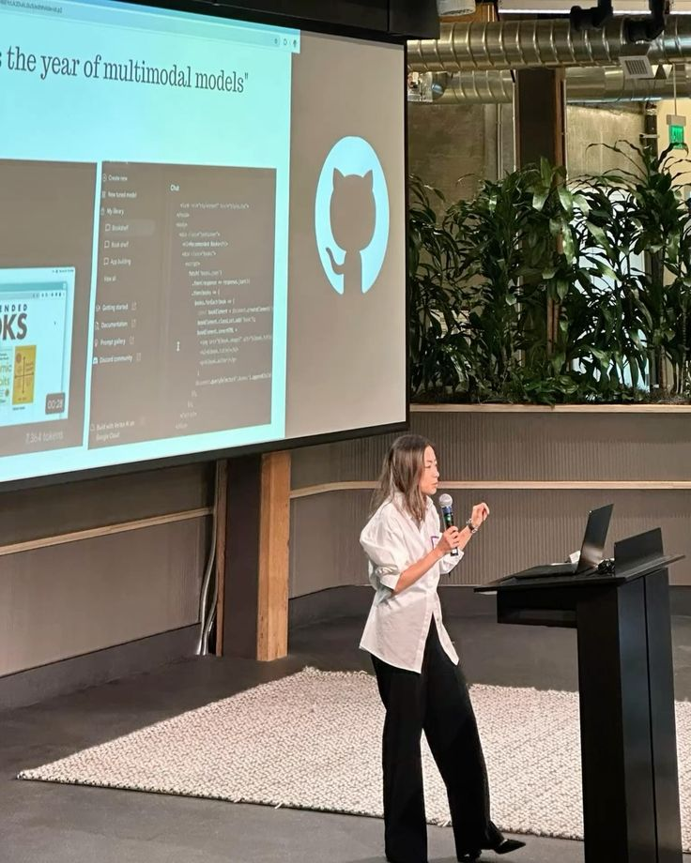
Examples of Effective Digital Tools
1
Virtual Classrooms
Platforms like Zoom or Microsoft Teams enable live, interactive language lessons with shared whiteboards, breakout rooms, and multimedia content.
2
Language Apps
Apps like Duolingo, Babbel, and Rosetta Stone provide personalized, gamified language practice with speech recognition and adaptive learning algorithms.
3
Online Tutorials
Comprehensive language learning platforms such as Coursera, edX, and Udemy offer self-paced, multimedia-rich courses with video lectures, interactive exercises, and assessments.

Slide 6
Integrating Digital Tools to Enhance Cultural Understanding
Virtual Exchanges
Multimedia Resources
Connecting classrooms across Europe for collaborative projects and cultural exchange.
Leveraging digital content like films, music, and art to immerse students in European cultures.
Interactive Media
Streaming Services and Multimedia Content
Games and interactive quizzes focused on cultural practices or history can make learning engaging and memorable. For instance, exploring cuisines, music, or attire from around the globe through gamified apps offers both fun and knowledge.
Films, documentaries, and TV shows on platforms like Netflix or YouTube often reflect cultural identities and histories. Subtitled content further allows users to engage with foreign languages and storytelling traditions

Slide 7
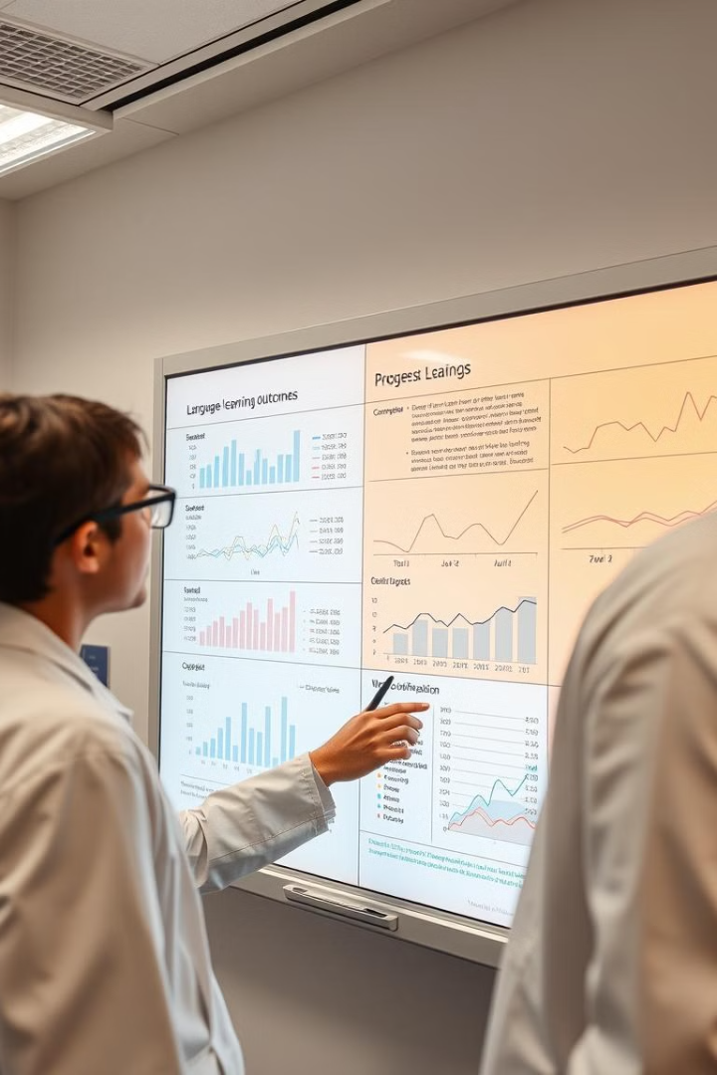
Evaluating the Effectiveness of Digital Tools
Improved Learning Outcomes
Increased Engagement
Studies show digital tools can enhance language proficiency, retention, and confidence.
Learners report higher motivation and enjoyment with interactive, personalized digital experiences.
Cost-Effective Scalability
Digital solutions offer a more accessible and sustainable approach to language education.

Slide 8
Strategies for Implementing Digital Tools
Assess Needs
1
Identify target language skills, learner profiles, and institutional constraints.
Select Tools
2
Match digital solutions to specific learning objectives and pedagogical approaches.
Train Educators
3
Provide comprehensive professional development to ensure effective integration.
Monitor and Iterate
4
Continuously evaluate the impact of digital tools and make adjustments as needed.

