Slide 1


European Universities and Their Language Teaching Approches

Slide 2
1.Why this topic matters?
More engaging and enjoyable learning
Personalized Learning Experiences
Access to real-world language usage (virtual exchanges, social media, and online forums )
Students can access materials and practice anytime, anywhere ( Flexibility and Accessibility )
Quicker and more detailed assessments of student progress

Slide 3

2. Examples of Applications
Known for its gamified approach, Duolingo is widely used as a supplementary tool in university language courses.

Slide 4

2. Examples of Applications
Known for its gamified approach, Duolingo is widely used as a supplementary tool in university language courses.
This app combines videos of native speakers with spaced repetition techniques, ensuring students retain what they learn.

Slide 5

Known for its gamified approach, Duolingo is widely used as a supplementary tool in university language courses.
This app combines videos of native speakers with spaced repetition techniques, ensuring students retain what they learn.
A powerful translation tool praised for its accuracy, especially with European languages, and often used in academic contexts.

Slide 6

3. Examples of Applications
Known for its gamified approach, Duolingo is widely used as a supplementary tool in university language courses.
This app combines videos of native speakers with spaced repetition techniques, ensuring students retain what they learn.
A powerful translation tool praised for its accuracy, especially with European languages, and often used in academic contexts.
It focuses on conversational skills and cultural nuances, providing students with practical language skills.

Slide 7

3. Examples of Applications
It focuses on conversational skills and cultural nuances, providing students with practical language skills.
Known for its gamified approach, Duolingo is widely used as a supplementary tool in university language courses.
This app combines videos of native speakers with spaced repetition techniques, ensuring students retain what they learn.
A powerful translation tool praised for its accuracy, especially with European languages, and often used in academic contexts.
A dictionary and translation hybrid, Linguee is perfect for understanding word meanings in context.

Slide 8


3. Examples of Applications
It focuses on conversational skills and cultural nuances, providing students with practical language skills.
Known for its gamified approach, Duolingo is widely used as a supplementary tool in university language courses.
This app combines videos of native speakers with spaced repetition techniques, ensuring students retain what they learn.
A powerful translation tool praised for its accuracy, especially with European languages, and often used in academic contexts.
A dictionary and translation hybrid, Linguee is perfect for understanding word meanings in context.
STOCKHOLM UNIVERSITY ( SWEDEN )
Speech Recognition Software:

Slide 9
Known for its gamified approach, Duolingo is widely used as a supplementary tool in university language courses.
This app combines videos of native speakers with spaced repetition techniques, ensuring students retain what they learn.
A powerful translation tool praised for its accuracy, especially with European languages, and often used in academic contexts.
It focuses on conversational skills and cultural nuances, providing students with practical language skills.
A dictionary and translation hybrid, Linguee is perfect for understanding word meanings in context.
STOCKHOLM UNIVERSITY ( SWEDEN )
Speech Recognition Software:

Slide 10



Stockholm University (Sweden)
Innovative Approaches:
Speech Recognition Software:
  Leverages advanced tools to help students practice and refine pronunciation and fluency.
Global Collaboration Projects:
  Connects students with peers worldwide through online platforms and partnerships.
Why It's Innovative:
Integrates speech technology with global collaboration.
Prepares students for real-world communication in a globalized world.
University of Copenhagen (Denmark)
- Digital platforms, Integrates Tools

Slide 11
University of Copenhagen (Denmark)
- Digital platforms, Integrates Tools

Slide 12






Technology-Enhanced Learning:
  Integrates tools like SpeechAce and Rosetta Stone for personalized pronunciation feedback.
  Offers virtual classrooms to accommodate remote learners.
Focus on Scandinavian Languages:
  Provides comprehensive courses in Danish, Swedish, and Norwegian using both digital platforms and classroom instruction.
Why It's Innovative:
  Blends technology-assisted tools with cultural exchange opportunities.
  Specializes in regional languages to promote linguistic and cultural proficiency.
University of Edinburgh (Scotland, UK)
- Virtual and Augmented Reality (VR/AR)

Slide 13
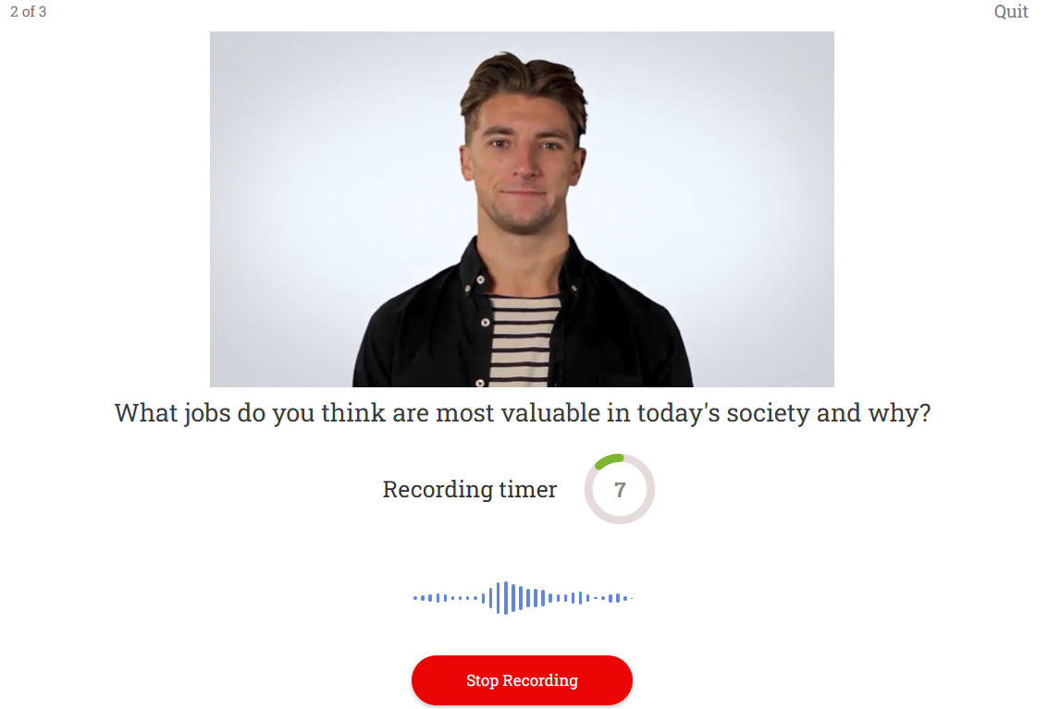

Slide 14
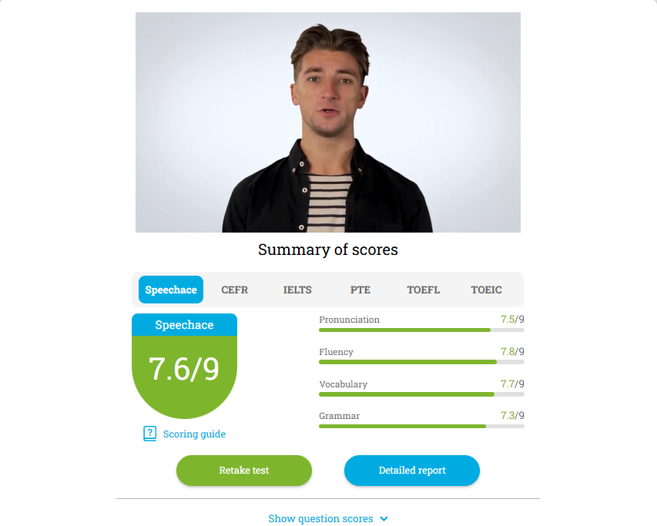

Slide 15
Results
University of Edinburgh (Scotland, UK)
- Virtual and Augmented Reality (VR/AR)

Slide 16
University of Edinburgh (Scotland, UK)
- Virtual and Augmented Reality (VR/AR)

Slide 17



Innovative Approaches:
Virtual and Augmented Reality (VR/AR):
  Creates immersive language learning environments, simulating settings like cultural events or virtual travel.
Interactive Workshops & Language Labs:
  Features peer-to-peer learning, debates, and cultural immersion for dynamic engagement.
Language Learning via Film & Media:
  Uses films, podcasts, and media to teach language in context, fostering practical understanding.
University of Helsinki (Finland)
Gamification in Learning, Digital Tools Integration

Slide 18
University of Helsinki (Finland)
Gamification in Learning, Digital Tools Integration

Slide 19
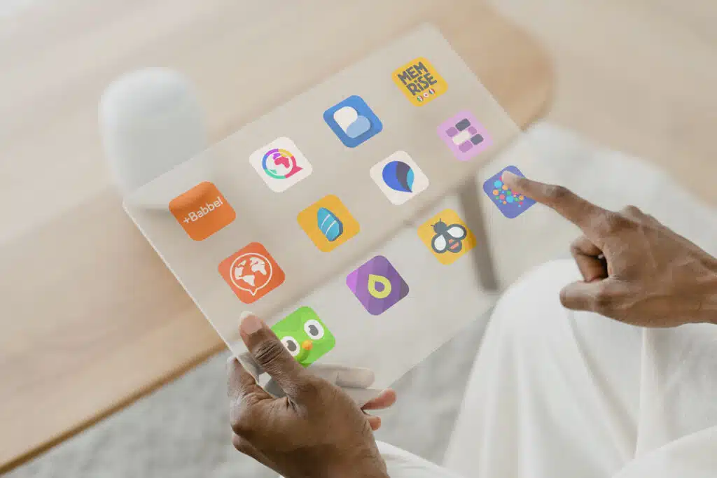

Digital Tools Integration:
Offers apps and interactive online courses blending self-paced study and in-person instruction.
Gamification in Learning:
Uses game-based learning platforms and simulations in language courses.
Engages students in virtual real-world scenarios like debates and dialogues.
Focus on Multilingualism:
Courses available in Finnish, Swedish, English, and more.
Emphasizes the cognitive benefits of multilingualism.
Why It's Innovative:
Combines gamification and immersive digital platforms.
Creates interactive, engaging, and real-world learning experiences.
University of Barcelona (Spain)
- Mobile Language Learning

Slide 20
University of Barcelona (Spain)
- Mobile Language Learning

Slide 21


University of Barcelona (Spain)
Innovative Approaches: Language Learning Apps and Software:
Duolingo: some language departments integrate language apps like Duolingo to support self-paced learning.
Rosetta Stone: Occasionally used for specific language courses to offer immersive language experiences.
Lingua.ly: Some language departments use this vocabulary-building tool, which supports language learning through web reading and flashcards.
Busuu : online language-learning app and website that provides comprehensive courses for a variety of languages. It combines lessons with practice exercises and social interactions.
Universität Leipzig (Germany)
- digital labs

Slide 22
Universität Leipzig (Germany)
- digital labs

Slide 23
Blended Learning:
  Combines face-to-face instruction with digital resources for in-class and self-paced learning.
Digital Language Labs:
  Features speech recognition technology to record and analyze pronunciation for improved speaking skills.
Cultural Immersion:
  Immerses students in German culture through local events, internships, and native speaker collaboration.
Why It's Innovative:
Enhances language acquisition with cutting-edge digital tools.
Balances technical learning and cultural immersion for a holistic approach.

Slide 24
Benefits of Using Digital Tools
Challenges to Consider
Flexible learning anytime, anywhere.
Over-reliance on technology might hinder deeper learning.
Personalized and adaptive learning paths.
Costs of premium features in apps for some students.
Collaborative learning with global peers.
Not all languages are supported equally by tools like DeepL or Duolingo.
High accuracy in translations, supporting academic writing.

Slide 25
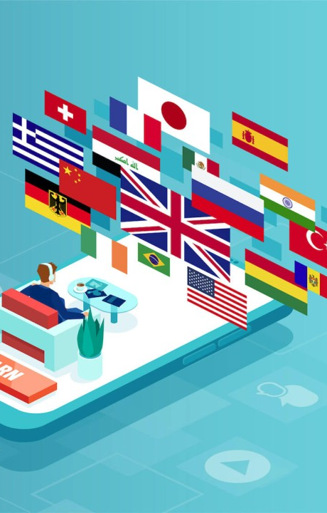
7. Conclusion
Technologies in language learning offers significant advantages
By incorporating technology, language teachers can create more effective and engaging learning environments that better prepare students for real-world communication
we can’t rely only on digital language learning
thanks to technologies we have great tools to make the proces of language learning more effective
Combining these tools with traditional methods is key to success.

