Slide 1





Digitalization and the Future of EU Enlargement
Student of the faculty of International relations
Elmir Mammadov 58909

Slide 2

Introduction
For a long time, the European Union (EU) has relied on its expansion program to provide economic possibilities, extend its ideals, and stabilize bordering areas. But this process has additional aspects in the digital era.
Digitalization is increasingly essential to bringing candidate nations into compliance with EU governance, economic, and social norms; it is no longer a supplemental instrument. The EU speeds up the expansion process by improving regulatory compliance, promoting connectivity, and digitizing public services.

Slide 3
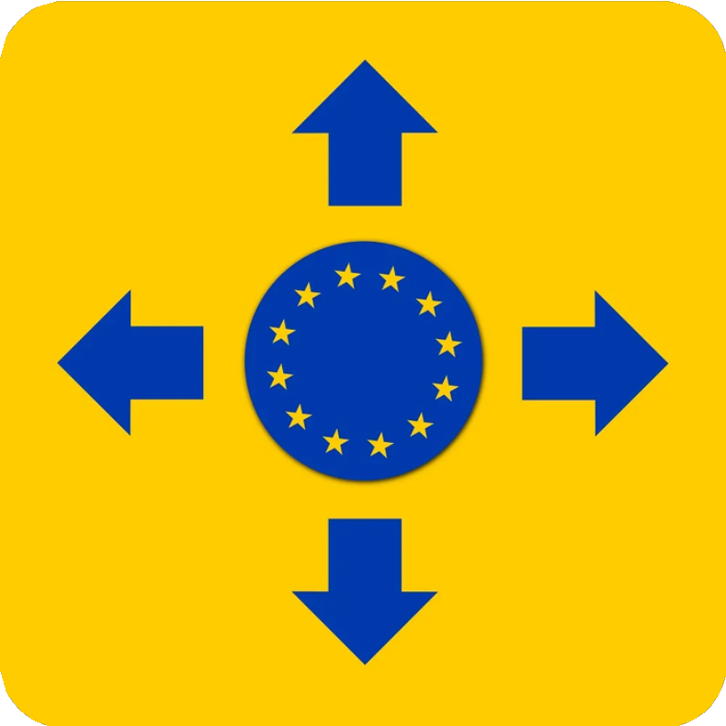
Role of Digital Tools in EU Enlargement
Digital tools play a crucial role in the European Union's enlargement process by fostering better governance, connectivity, and economic integration in candidate and neighboring countries. Through initiatives like the Digital Europe Programme and the Digital Decade Targets, the EU supports these nations in meeting key accession criteria such as transparency, efficient administration, and democratic stability. These programs emphasize high- speed internet access, digital education, and robust cybersecurity, which reduce digital divides and enhance institutional effectiveness.
By adopting digital tools, aspiring member states align more closely with EU standards while enhancing cross-border cooperation and trust. Moreover, digital strategies help address challenges like disinformation and promote secure data sharing, both essential for stable integration. These efforts not only strengthen candidates' readiness but also contribute to the EU's broader objectives of geopolitical stability and technological leadership

Slide 4
Bridging the Gap Between EU and Candidate Countries
Digital tools are vital for connecting the European Union with candidate countries, enabling closer alignment in governance, economy, and societal development. Programs like the Digital Europe Programme and initiatives such as EU4Digital focus on improving digital connectivity, fostering skills development, and modernizing public services. Investments in these areas help reduce the digital divide and enhance institutional capacities, making it easier for candidate countries to meet EU accession requirements.
Digital transformation supports transparency, efficient governance, and cross- border cooperation by enabling secure data exchange and harmonized standards. Initiatives like Erasmus+ also facilitate skills sharing and collaboration, ensuring citizens and businesses in candidate countries are well-prepared for economic and digital integration. These efforts contribute to building a more inclusive and interconnected Europe, paving the way for successful enlargement

Slide 5
Digital Skills and Economic Inclusion
Digital skills are increasingly vital for fostering economic inclusion in the European Union. As digital transformation reshapes job markets, individuals without digital literacy face barriers to employment and social mobility. EU initiatives, such as the European Skills Agenda and the Digital Skills and Jobs Coalition, address this gap by promoting reskilling and upskilling efforts.
The EU aims to equip at least 80% of adults with basic digital skills by 2030. Programs like the Pact for Skills and Digital Europe Programme focus on inclusivity, targeting underrepresented groups, including women, low-skilled workers, and NEET youth (not in education, employment, or training). The European Social Fund Plus also allocates €99 billion for skills training to bolster economic participation across member states and candidate countries.
Digital skills not only enable individuals to access better job opportunities but also
foster entrepreneurial innovation, thus driving economic growth and reducing inequalities.

Slide 6

Challenges in Digital Governance
Digital governance within the EU faces complex challenges that arise from the rapid digitization of societies and economies. One key issue is data sovereignty, where large global tech companies dominate data collection and processing. This creates risks of unequal economic benefits and inadequate data protection, despite regulations like the GDPR. Additionally, disparities in digital infrastructure across member states exacerbate inequalities, limiting uniform governance implementation and innovation potential.
Another significant challenge is the protection of democratic processes. Digital platforms, while transformative, can facilitate disinformation and election interference. Ensuring transparency and accountability in algorithmic decision- making is critical for maintaining trust.
Moreover, the EU must address the fragmentation of digital policies across member states. Coordinating regulations and fostering public-private partnerships is vital to balance innovation with regulation. The EU's Data Governance Act and related frameworks aim to enhance cooperation and protect citizens' rights while leveraging data for public good

Slide 7
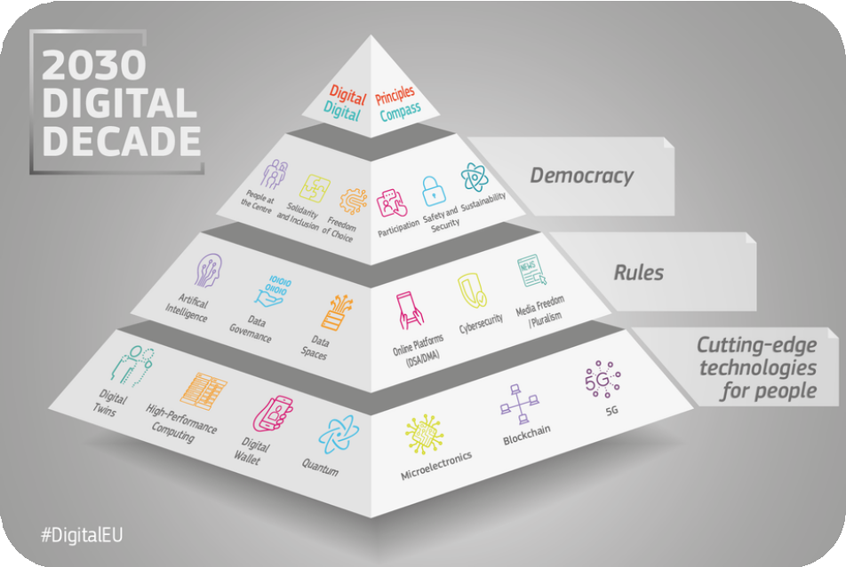
Strategies for Overcoming Digitalization Challenges
The EU is addressing digitalization challenges through a multifaceted approach focused on skills, infrastructure, security, and innovation.
By 2030, the EU aims for 80% of its population to possess basic digital skills, supported by programs like the Digital Education Action Plan and Erasmus+. This includes initiatives to attract and retain talent in emerging fields like AI and cybersecurity, crucial for economic and societal resilience. Investments in robust digital infrastructure, such as gigabit networks and secure 5G, are also central to ensuring inclusive participation across regions. Regulatory frameworks like the Digital Services Act and Digital Markets Act promote secure, transparent online environments while safeguarding democratic processes.
Public-private collaborations are pivotal for harmonizing digital policies and fostering innovation, bridging gaps between member states and ensuring the EU’s competitive edge globally.

Slide 8

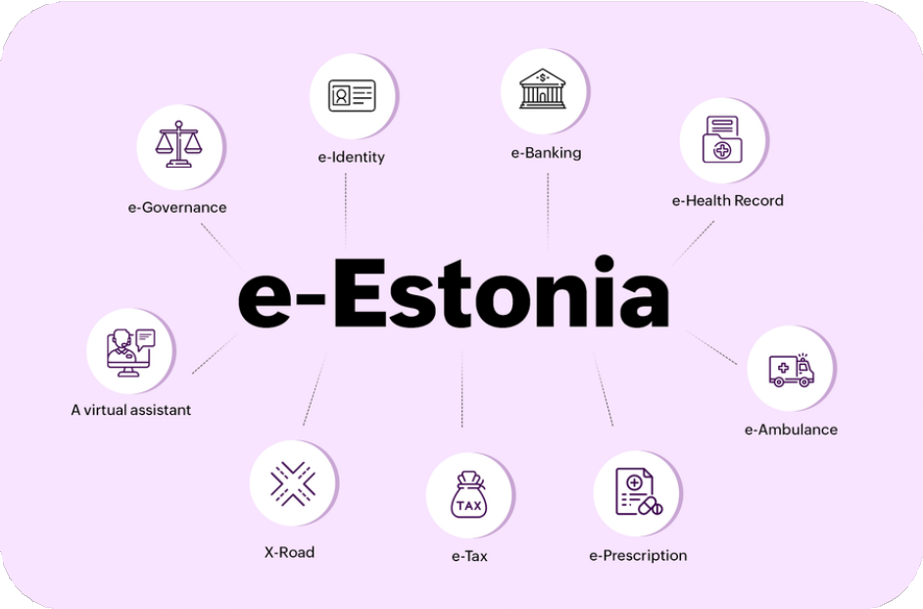
Success Stories
The European Union has achieved several notable successes in its digital transformation efforts, showcasing how innovative digital strategies can drive growth and foster integration. Ukraine, despite geopolitical challenges, has developed the Diia app, which offers digital government services such as passports and business registration. This initiative, recognized as a model within the EU, demonstrates the potential of a "digital-first" governance approach to enhance accessibility and efficiency. Estonia has also set global benchmarks with its e-governance systems, enabling online voting, tax management, and healthcare access, along with its e-Residency program that allows entrepreneurs to establish EU-based businesses remotely. Similarly, IKEA embraced e-commerce transformation by integrating digital tools to streamline operations and enhance customer experiences, tripling its online sales. McDonald’s Italy reimagined its procurement processes through digital portals, improving supplier collaboration and operational efficiency across its supply chain.
These examples highlight the power of digital tools in fostering innovation, improving public services, and driving economic inclusivity.

Slide 9
References
1.https://commission.europa.eu/system/files/2021-09/communication-digital-compass- 2030_en.pdf
https://www.europarl.europa. eu/RegData/etudes/BRIE/2021/6 96189/EPRS_BRI(2021)696189_E
N.pdf
https://planergy.com/blog/digit al-transformation-success-stories/
2.https://commission.europa.eu/document/download/84c05739-547a-4b86-9564- 76e834dc7a49_en?filename=communication-shaping-europes-digital-future-feb2020_en.pdf
https://ec.europa.eu/commission/presscorner/api/files/attachment/861987/Shaping
_Europes_Digital_Future_en.pdf
https://digital-strategy.ec.europa.eu/en/activities/digital-programme
https://www.theparliamentm agazine.eu/news/article/oped- ukraine-leads-the-way-on-digital- integration-with-the-eu
/https://www.digital- adoption.com/digital- transformation-success- stories/
https://www.digitalsme.eu/succe ss-stories-and-leadership-from- europes-digital-innovation-hubs/
5.https://eufordigital.eu/
6.https://www.europarl.europa.eu/RegData/etudes/BRIE/2021/696189/EPRS_BRI(2021)696189_EN.pdf
7.https://ec.europa.eu/social/main.jsp?catId=1223&langId=en
8.https://digital-skills-jobs.europa.eu/en/actions/european-initiatives/european-skills-agenda
9.https://commission.europa.eu/strategy-and-policy/priorities-2019-2024/europe-fit-digital-age/european-year-skills-2023_en

Slide 10
Thank You for attention!

