Slide 1
Bringing Digital Resources for Learning Ukrainian on Par with Those for World Languages

Slide 3
With the other 2 students, I was lucky to
work at
the Centre under
Ukrainian Language
Education Alberta
at the University of
of
the supervision
Professor Bilash on the project concerned with creating educational videos dedicated to the Sustainable Development Goals for those, who learn Ukrainian as a foreign language.
A screenshot from one of the created videos

Slide 4
The project constitutes an opportunity to create new resources that
reflect contemporary realities, cultural representations and topics of
the Ukrainian
sustainability in today’s Ukraine, the 40 countries of
diaspora and beyond. As such it attempts to bring Ukrainian language
video resources on par with other international languages.

Slide 5
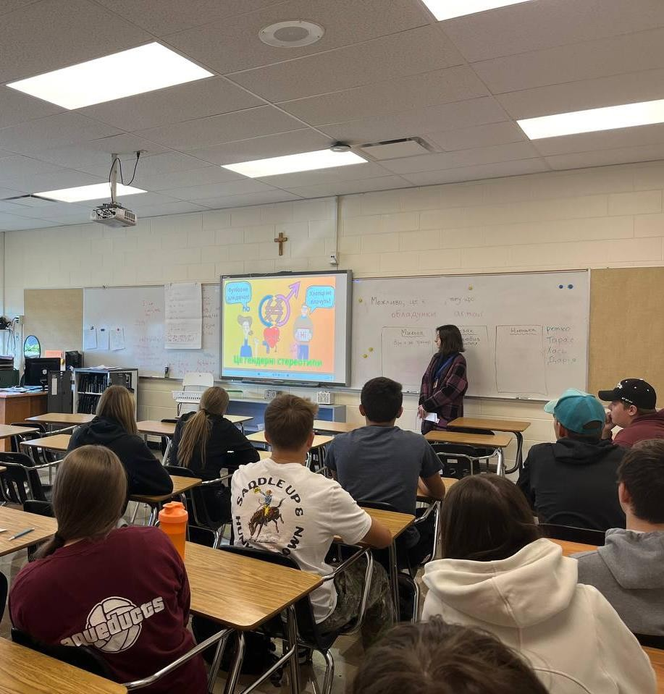
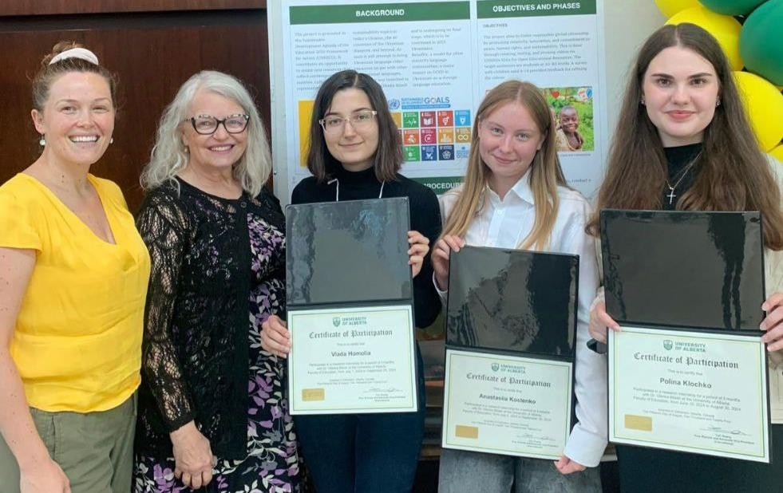
Our main responsibilities included:
literature review
writing scripts tailored to specific levels of language proficiency
visual design and animation
Additionally, we were involved in:
voicing the videos
creating and conducting a survey on the effectiveness of the developed educational materials

Slide 6
A screenshot from “15-minute city: Melbourne”
Being a native speaker, I struggled with writing scripts intended for A1-B2 users. I couldn’t immediately notice which grammatical structures or words were too complex. The task was even harder due to the fact that the videos I was working on dealt with rather complex topics, such as the concept of 15-minute cities or innovations.
A screenshot from “Innovations”

Slide 7
However, thanks to experience and my professor’s help, I managed to develop a set of 3 principles that helped me create educational texts that met the needs of students with different proficiency levels:

Slide 8
subject
predicate
adverbial modifier
1. Adhering to a certain word order.
In Ukrainian the word order is free, so I had never thought about the important role it could play for non-native speakers while perceiving speech.

Slide 9
2. Repeating the same words and grammar constructions
This strategy may seem quite obvious, but I had neglected it due to the habit of avoiding repetition and writing as melodically as possible.

Slide 10
нам
нашу
3. Minimal use of pronouns, prepositions, particles
The reason behind this principle is that these parts of speech are intuitively difficult for beginners to understand, since they carry mostly grammatical meaning or name something indirectly.

Slide 11
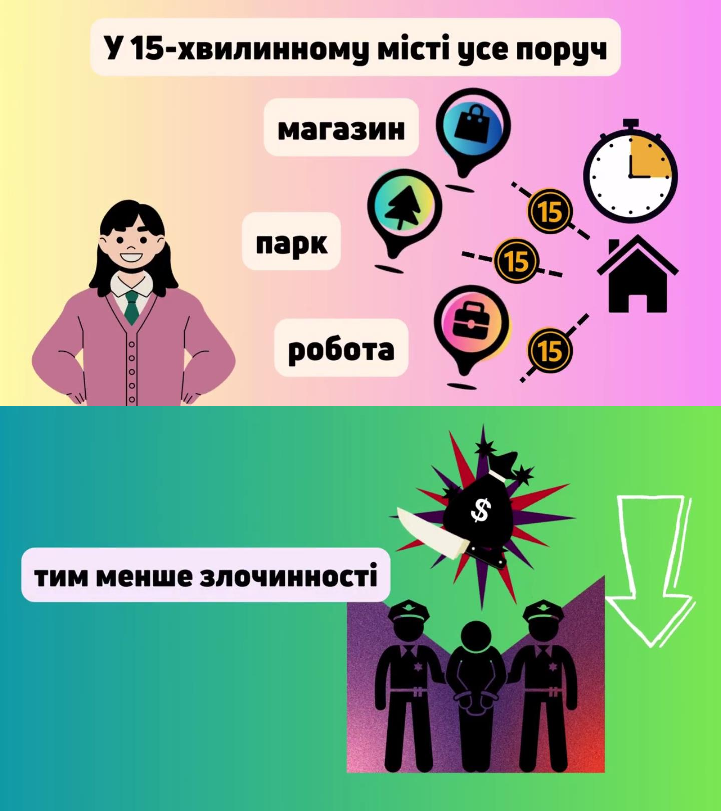
The ability to put complex ideas in simple words is a key skill for a teacher, so I truly value the fact that this internship allowed me to develop this ability.

Slide 12
The project is so significant for me not only because of the knowledge I’ve gained, but also due to its mission. This research helps bring educational materials in Ukrainian closer to the level of world languages. This is crucial for the representation of Ukrainian culture on a global scale, it positively influences cultural exchange and the development of national identity.

