Slide 1
Shaping Minds and Power:
Insights from a European Summer School on Public Opinion and Political Influence
by Sannikova Valeriia,
master’s degree student, Department of Foreign and Slavic Philology

Slide 2
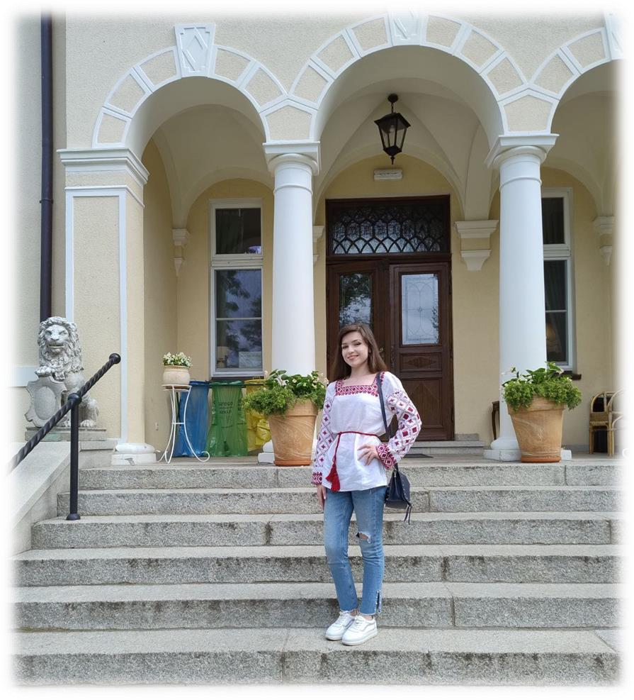
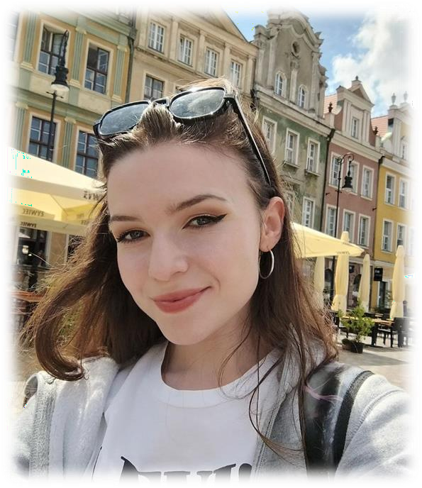
About me
My name is Valeriia, I am a master’s degree student at Sumy State Pedagogical University named after A.S. Makarenko.
This summer, I had the opportunity to participate in an internship at a Polish summer school in Poznań.
The primary goal of this internship was to deepen my understanding of the problem: "Inspiration and Manipulation of Public Opinion as Algorithms for Gaining and Maintaining
Political Power in Europe.”
This experience allowed me to explore contemporary approaches to political communication and public opinion dynamics in a European context, enriching my academic and professional perspectives.

Slide 3
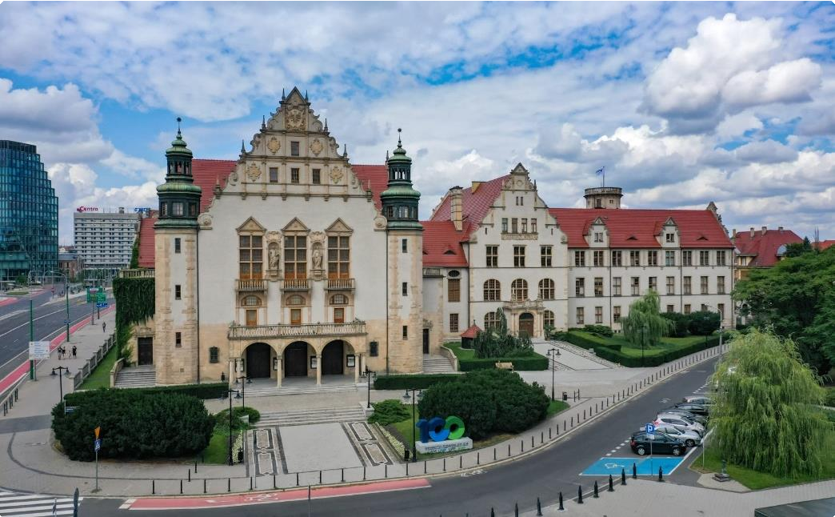
Background of the Summer School
Event Overview:
Location: Poznań, Poland.
Organizers: Department of Philosophy, Adam Mickiewicz University.
Dates: July 1 to July 6.
Key Theme: Focus on "Inspiration and Manipulation of Public Opinion as Algorithms for Gaining and Maintaining Political Power in Europe.“
Participants and Language of Instruction:
26 participants from various countries und universities. Lectures delivered in English and Polish.

Slide 4
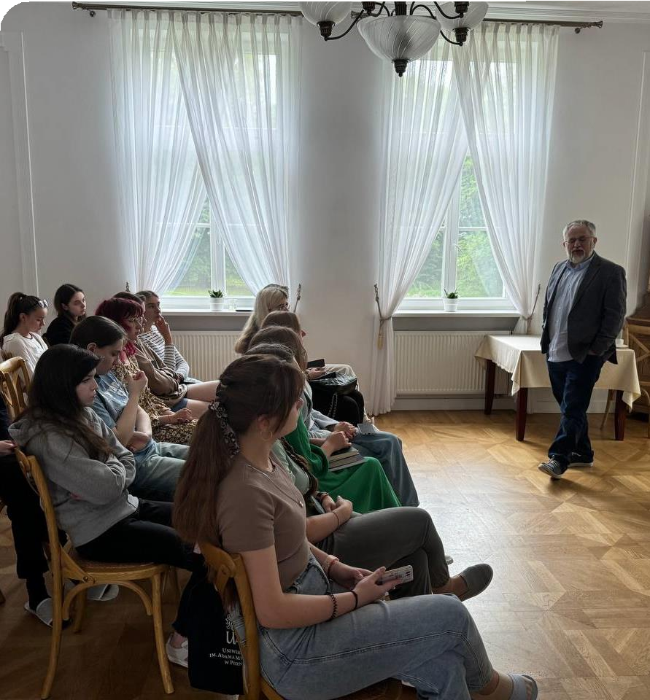
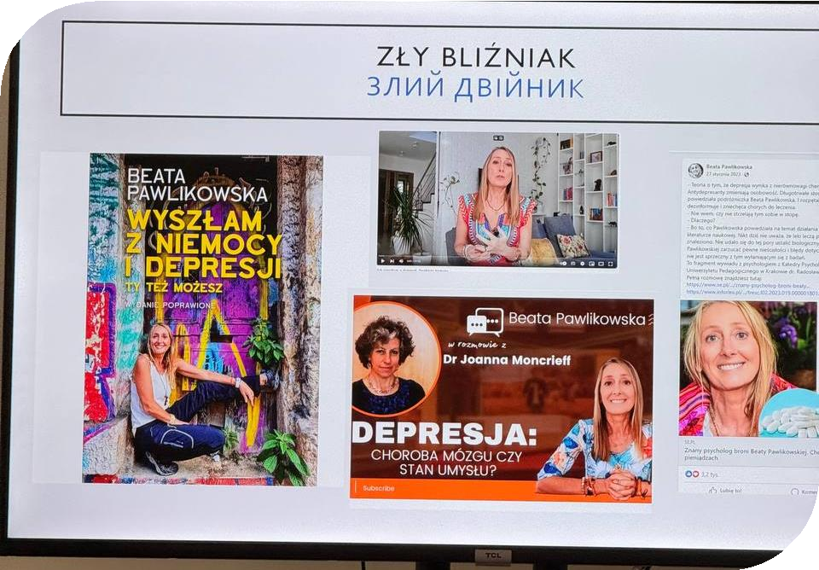
Structure of the Summer School
The Dynamics of Public Opinion:
How public opinion is shaped by media, cultural narratives, and political strategies.
Role of algorithms and data-driven techniques in
modern political campaigns.
Manipulation vs. Inspiration:
Ethical considerations in influencing public opinion. Balancing persuasive strategies with transparency and truth.
Case Studies from Europe:
Examples discussed during the program (e.g., historical or contemporary European political scenarios).
Relevance to Current Political Trends:
Connection to rising populism, the role of social media, and public sentiment in Europe

Slide 5
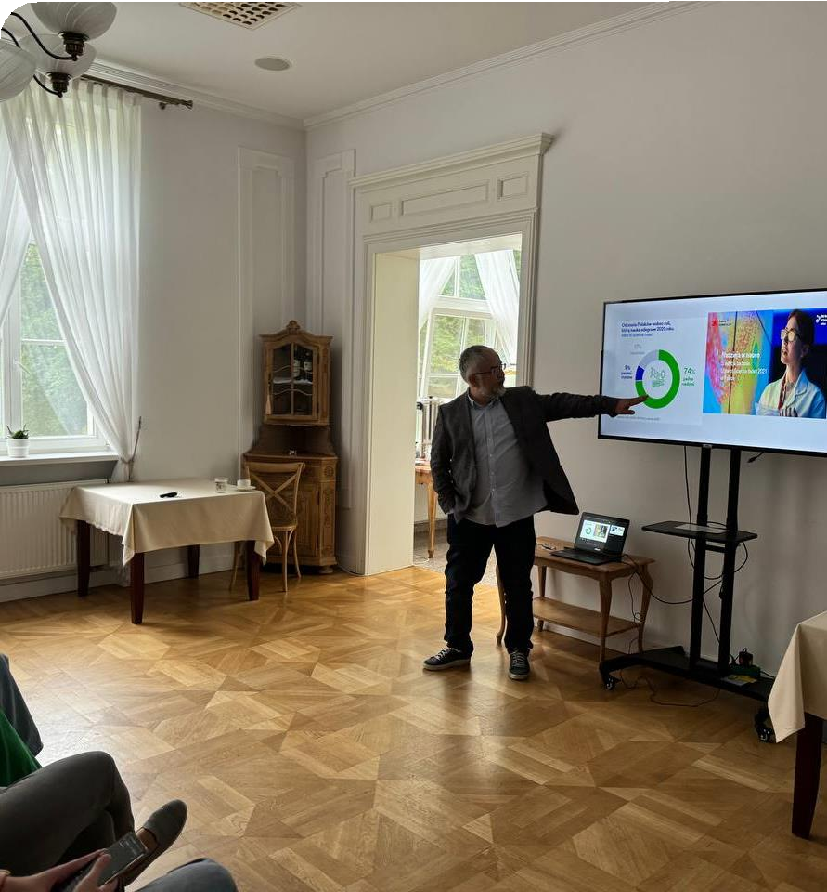
Workshop Highlights
During the internship, workshops were designed as dynamic and collaborative sessions that emphasized active participation from all attendees.
These workshops often included:
Group simulations: role-playing exercises where participants acted as political strategists or media representatives to design campaigns or respond to crises.
Case studies: analysis of real-world examples of public
opinion manipulation in European political contexts.
Debates: structured discussions where participants argued opposing viewpoints on ethical issues related to public opinion and political algorithms.

Slide 6
Relevance to My Studies
Connection to Master’s Degree Work
My master’s degree thesis focuses on the linguosemiotic space of modern English-language fashion media discourse.
The research examines the interplay between text and visuals in influencing readers' perceptions and emotions, particularly in the context of brand promotion and consumer behavior.
The internship in Poland deepened my understanding of how discourse—whether political or commercial—affects public opinion. The theories and practices I was engaged with during the summer school align closely with my academic interest in analyzing the persuasive mechanisms within media texts.

Slide 7
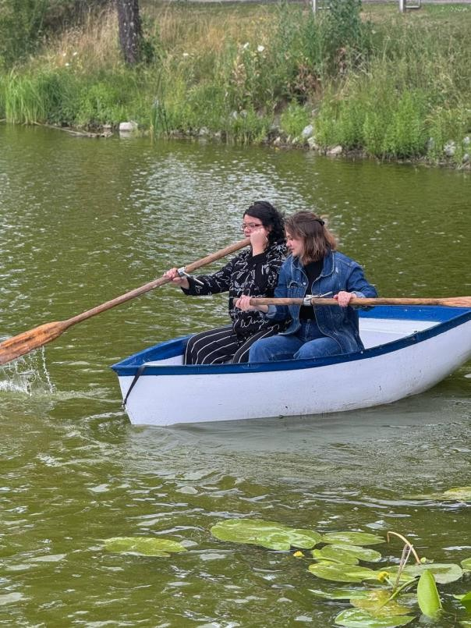
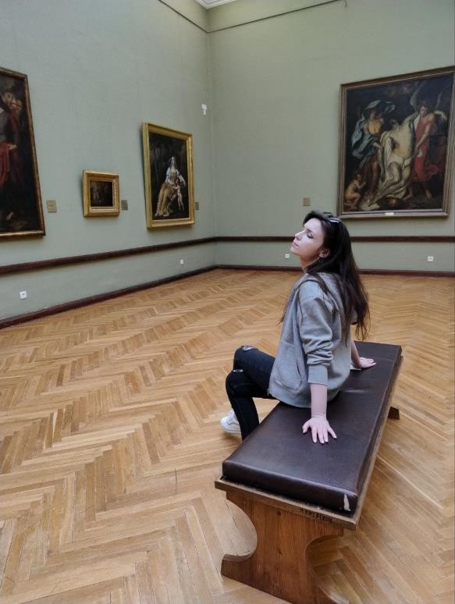
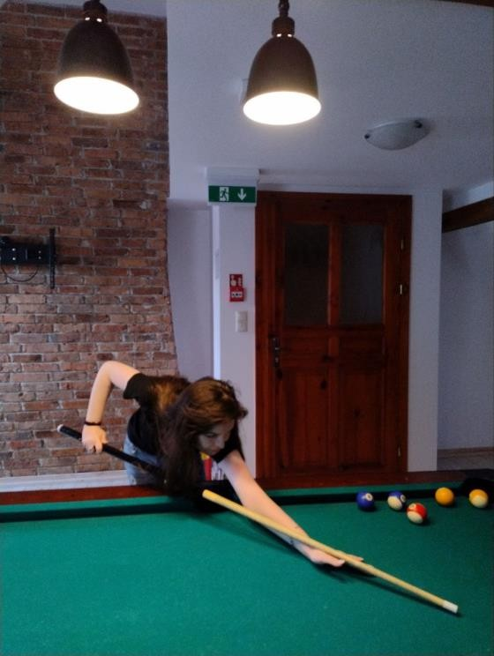
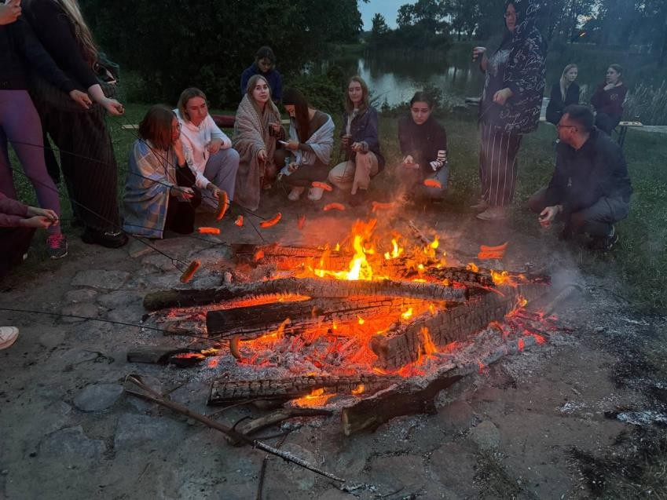
Outdoor Activities
Catamaran ride
Beyond the academic sessions, the summer school provided enriching outdoor activities that helped foster cultural exchange and relaxation among participants. These experiences balanced the intense learning schedule and allowed for informal interactions.
Bonfire Evening
Billiard game
Excursions

Slide 8
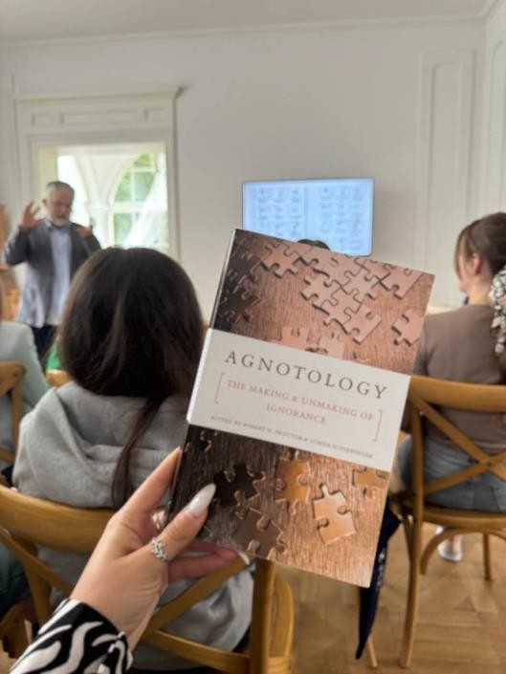
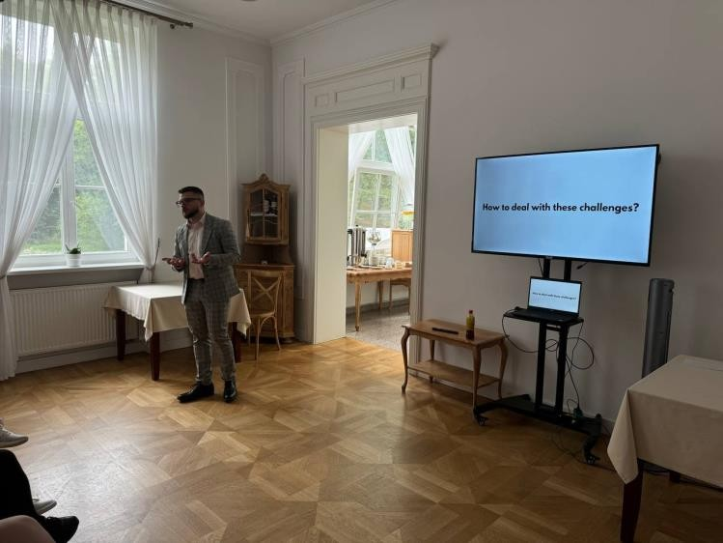
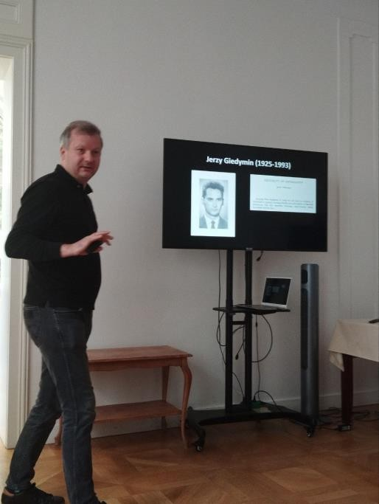
Personal Experience and Takeaways
Academic Growth:
New perspectives on political communication and public opinion. Application of knowledge to your field of study.
Skills Developed:
Critical thinking, analytical skills, and understanding of interdisciplinary approaches.
Networking and Cultural Exchange:
Collaborating with international peers. Gaining insights into diverse viewpoints and strategies.

Slide 9
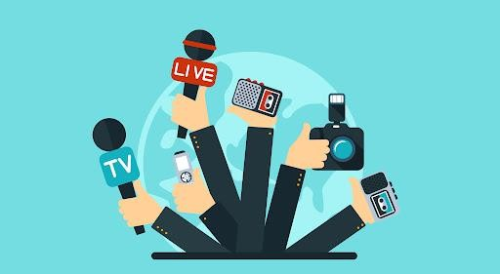
Future Implications
Global Relevance and Policy Impact
The lessons learned have implications for shaping global policy, particularly in areas like:
Combatting Fake News: developing strategies to counter disinformation campaigns.
Promoting Media Literacy: encouraging critical thinking in audiences to reduce susceptibility to manipulation.
Advancing Analytical Skills
The knowledge and skills gained during the internship provide a solid foundation for analyzing complex systems of communication, particularly the strategies used to manipulate public opinion. This insight can be applied to further research in various fields such as media studies, political science, and advertising.
Enhanced Professional Applications
The theoretical frameworks from the summer school, such as semiotic analysis and discourse theory, will enrich academic
projects like my master’s thesis. These concepts can also guide future research in media discourse and cultural studies.

Slide 10
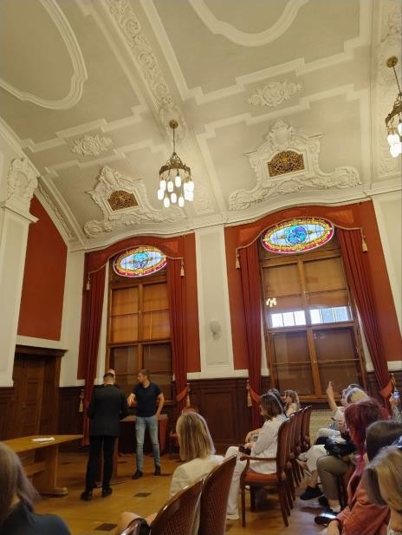
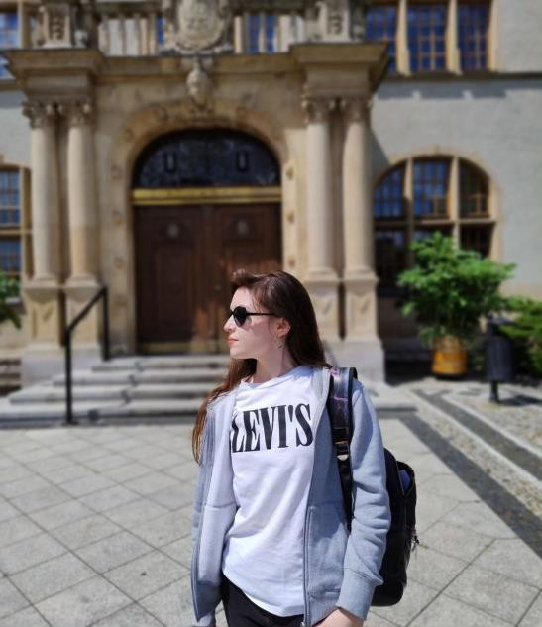
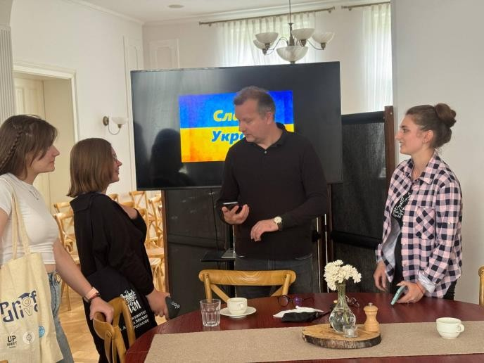
Conclusion
Purpose and Learning:
The summer school in Poland provided an invaluable opportunity to explore the
mechanisms of influencing and manipulating public opinion as tools for gaining and maintaining political power in Europe.
Through interactive lectures and
workshops, I deepened my understanding of critical concepts in communication, semiotics, and media analysis.
Relevance to Academic and Professional Growth
The theories and skills learned directly align with my master's thesis on fashion media discourse, enabling a deeper
analysis of how texts and visuals influence audiences.
Professionally, the program enhanced my ability to critically evaluate media strategies, making me more adept at understanding and creating impactful
messages in any communication field.
Future Implications
The internship laid a foundation for future research into ethical communication practices and
their global applications.
It highlighted the importance of media literacy and the responsible use of communicative tools to engage audiences meaningfully while avoiding manipulation.

Slide 11
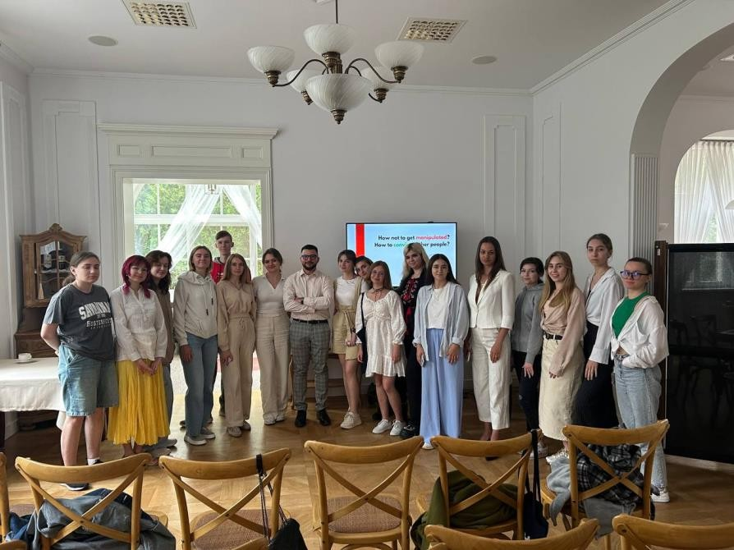
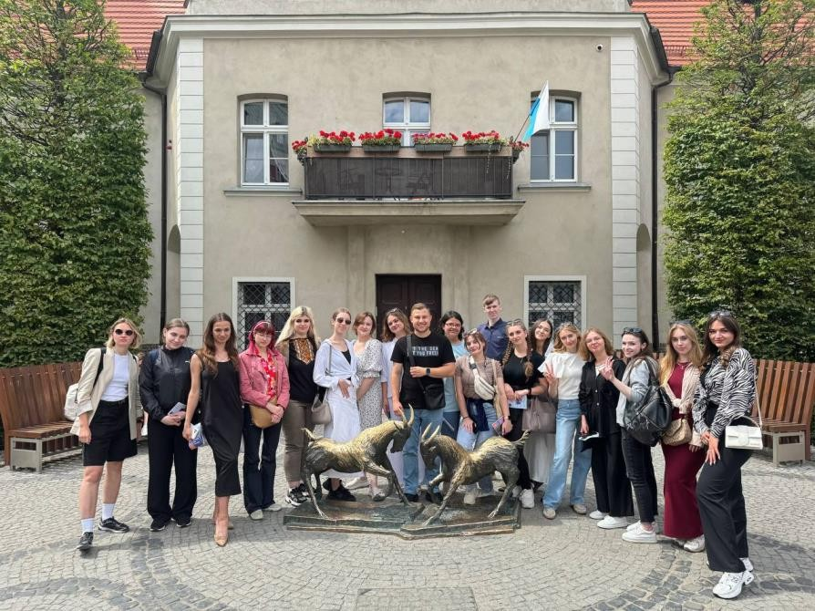
Implications for Ukraine and Beyond
11
Relevance to Ukrainian Context:
Parallels between European strategies and challenges faced in Ukraine.
Lessons for Ukrainian political communication and public engagement.
Global Perspective:
How the insights gained can be applied to international contexts.

Slide 12
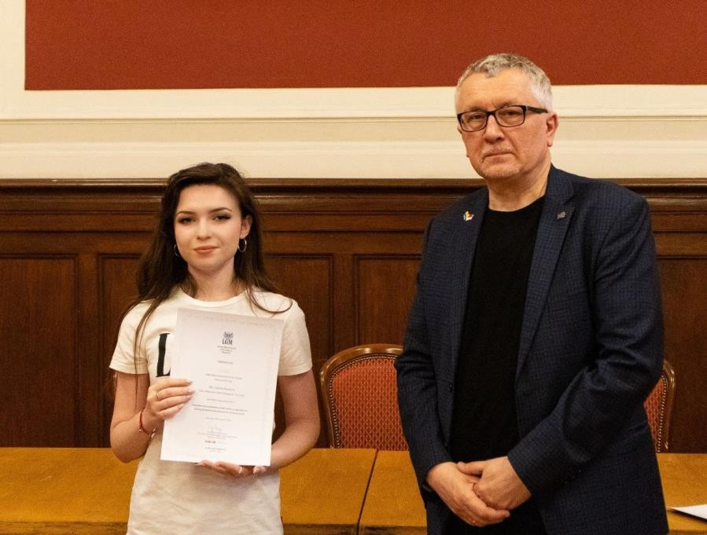
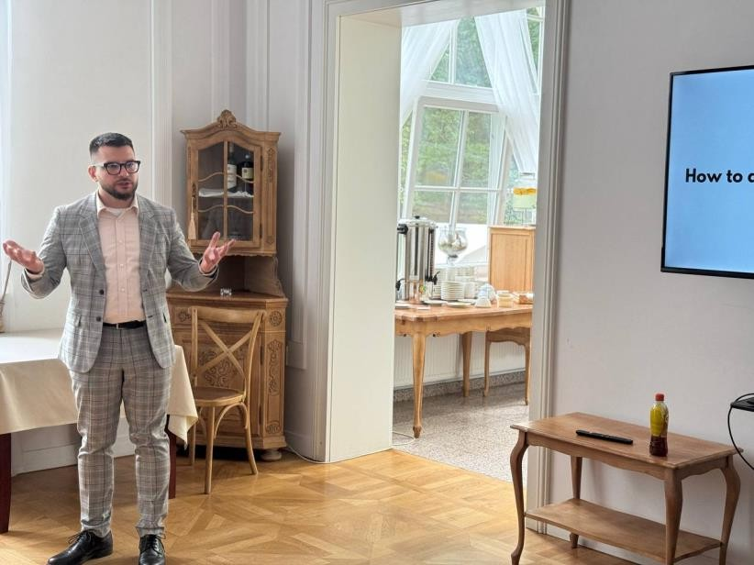
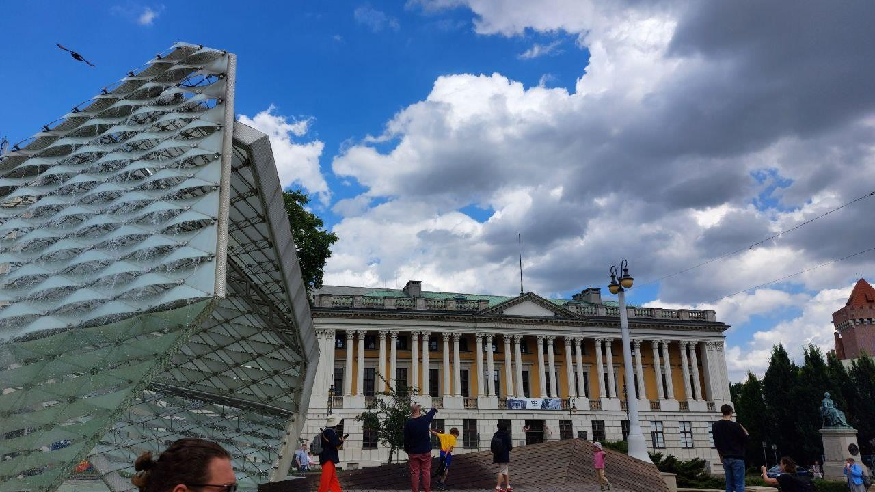
Thank you!

