Slide 1









studio shodwe
THE DIGITAL SINGLE MARKET:
Achievements, Challenges, and Future Prospects
Presentation by: Edmara Mabote
page 01

Slide 2


studio shodwe
WHAT IS THE DIGITAL SINGLE MARKET?
The Digital Single Market (DSM) is an initiative by the European Union to create a unified digital space where individuals and businesses can seamlessly engage in online activities across all EU member states. It aims to eliminate digital barriers, ensure fair competition, and promote innovation in the digital economy.
page 02
www.reallygreatsite.com

Slide 3


studio shodwe
The Digital Single Market (DSM) is centered around three key goals aimed at integrating and modernizing the EU's digital economy:
1. Better Access to Digital Goods and Services Across Borders
  Simplifying Cross-Border E-Commerce
  Content Portability
2. Creating an Environment for Digital Networks and Services to Thrive
  Developing High-Speed Infrastructure
  Enhancing Cybersecurity
  Promoting Fair Competition
3. Maximizing the Growth Potential of the Digital Economy
  Supporting Innovation
  Empowering Businesses
  Digital Skills Development
www.reallygreatsite.com

Slide 4
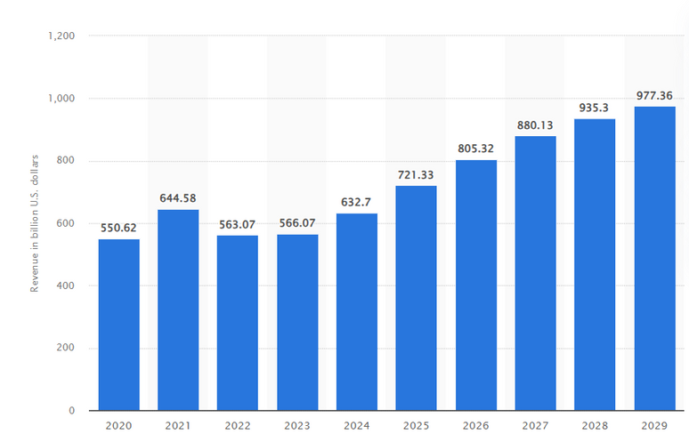
studio shodwe
ECONOMIC INTEGRATION: DSM’S SUCCESS
The Digital Single Market (DSM) has played a pivotal role in advancing the EU's economic integration by harmonizing digital regulations and fostering seamless cross-border activities.
  The DSM has simplified online trade by eliminating restrictions such as geo-blocking.
  E-commerce in the EU has grown by over 13% annually since the DSM’s implementation.
  Over 70% of EU citizens now shop online, with cross-border purchases steadily increasing.
  Since 2017, EU citizens can use mobile data, calls, and texts across member states at no additional cost.
  Saved consumers over €1 billion annually, fostering more travel and economic activity.
Revenue of the e-commerce market in Europe from 2020 to 2029

Slide 5
studio shodwe
ECONOMIC INTEGRATION: DSM’S SUCCESS
  Content portability rules now allow subscribers to services like Netflix or Spotify to access their content while traveling across the EU.
  Small and Medium Enterprises can now reach a customer base of over 450 million people without dealing with fragmented digital regulations.
  Platforms and funding opportunities like Digital Europe and Horizon Europe have helped enterprises innovate and compete globally.
  By fostering homegrown innovation and regulating tech giants, the DSM helps secure the EU's independence in the global digital economy.
Revenue of the e-commerce market in Europe from 2020 to 2029

Slide 6

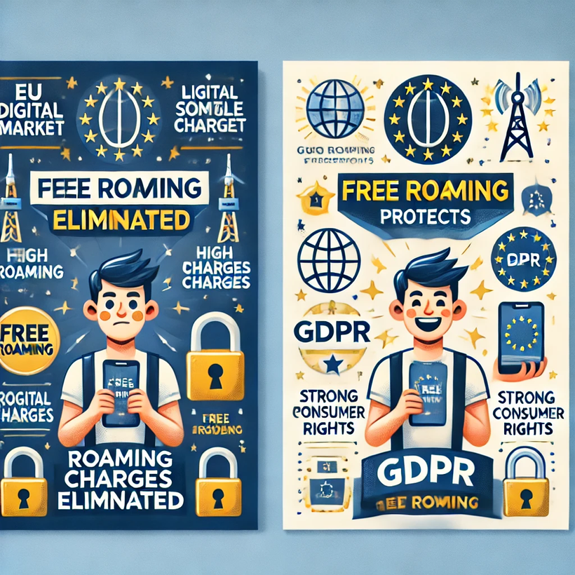
studio shodwe
EMPOWERING EU CONSUMERS
The EU Digital Single Market (DSM) has significantly enhanced consumer empowerment through initiatives such as:
  the elimination of roaming charges
  the enforcement of General Data Protection Regulation (GDPR)
The DSM's focus on consumer-friendly policies demonstrates the EU's commitment to making the digital economy accessible and reliable. It has encouraged mobility, boosted digital participation, and ensured that citizens feel secure in the digital age.
www.reallygreatsite.com

Slide 7



studio shodwe
THE DIGITAL DIVIDE IN THE EU
The digital divide refers to the disparities in access to and use of digital technologies across different regions and populations in the EU. Despite progress under the Digital Single Market (DSM), significant gaps persist.
www.reallygreatsite.com

Slide 8
THE DIGITAL DIVIDE IN THE EU
1. Unequal Access to Digital Infrastructure
  According to the Digital Economy and Society Index (DESI), only 60% of rural households have access to fast internet, compared to 90% in urban areas.
2. Variation Among Member States
  Northern and Western Europe lead in digital connectivity and literacy.
  In contrast, some Eastern and Southern EU nations lag due to limited investments and socio-economic challenges.
3. Economic Inequality
  Businesses in under-connected regions face challenges in accessing digital markets, limiting their growth potential.
  Citizens in poorly connected regions experience limited access to e-government services, healthcare, and digital banking.
www.reallygreatsite.com

Slide 9


studio shodwe
ADDRESSING NEW THREATS
1.
2.
3.
Cyber attacks
Misinformation and disinformation
Data privacy
Increased vulnerabilities due to emerging technologies like IoT, AI, and 5G.
Propaganda, fake news, and manipulated content threaten democratic processes, especially during elections.
Exploitation of personal data by corporations and cybercriminals.
www.reallygreatsite.com

Slide 10
studio shodwe
ADDRESSING NEW THREATS
4.
5.
6.
Social Inequities
Economic inequalities
Geopolitical Risks
Uneven access to digital technologies exacerbates the digital divide.
Dependence on non-EU tech giants raises concerns over digital sovereignty.
Automation and AI disrupt traditional job markets, risking mass unemployment.
www.reallygreatsite.com

Slide 11

studio shodwe
ADDRESSING NEW THREATS
4.
5.
6.
Social Inequities
Economic inequalities
Geopolitical Risks
Uneven access to digital technologies exacerbates the digital divide.
Dependence on non-EU tech giants raises concerns over digital sovereignty.
Automation and AI disrupt traditional job markets, risking mass unemployment.
www.reallygreatsite.com

Slide 12
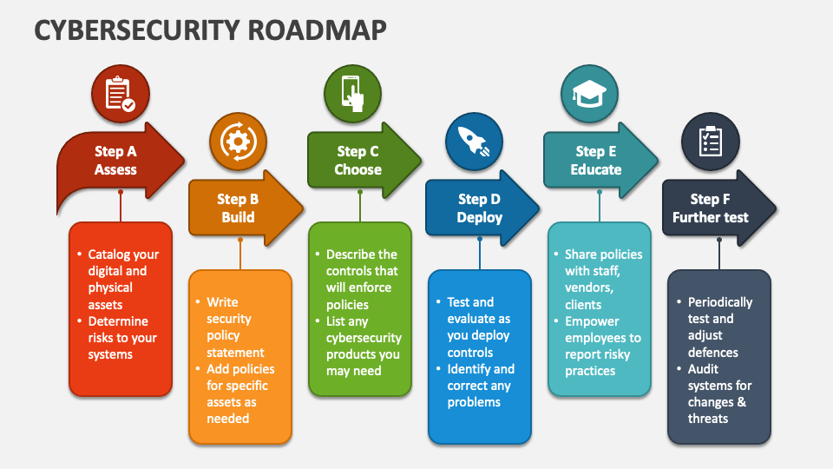

studio shodwe
UNLOCKING THE DSM’S POTENTIAL

Slide 13
studio shodwe
1.
Increase Rural Broadband Funding via the Connecting Europe Facility
Prioritize investments in rural and remote regions to achieve the EU 2030 goal of universal gigabit connectivity.
UNLOCKING THE DSM’S POTENTIAL
2.
Establish a Centralized EU Cybersecurity Agency
Transform the EU Agency for Cybersecurity (ENISA) into a centralized, fully empowered body with authority to coordinate member states' responses to cyberattacks.
www.reallygreatsite.com

Slide 14
studio shodwe
3.
Promote Homegrown Tech Innovation and Fair Competition
Enforce the Digital Markets Act to ensure fair competition and prevent market domination by Big Tech.
UNLOCKING THE DSM’S POTENTIAL
4.
Foster Digital Literacy and Inclusion
Expand the Digital Skills and Jobs Coalition, focusing on underrepresented groups such as the elderly, women, and those in disadvantaged areas.
www.reallygreatsite.com

Slide 15
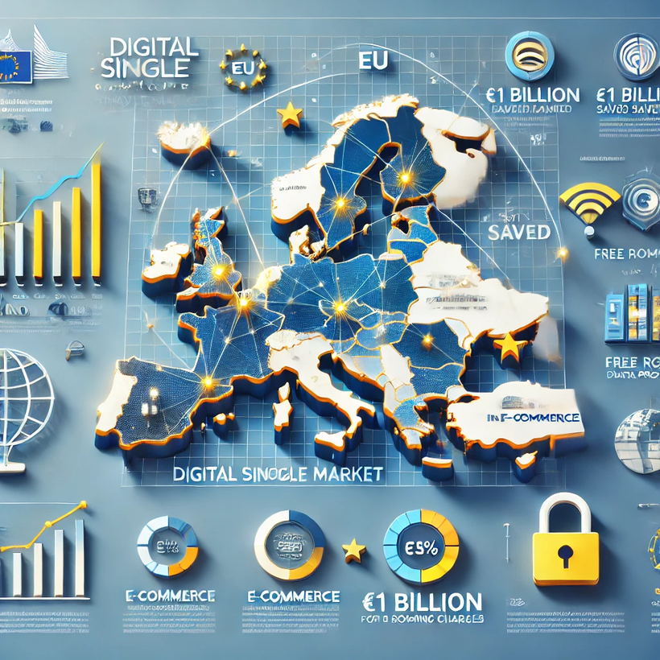
studio shodwe
A VISION FOR THE FUTURE
The vision for the future of the European Digital Single Market is one where innovation and sustainability go hand in hand, creating a fairer, greener, and more inclusive digital economy.
By focusing on digital empowerment, fostering global leadership in AI and green tech, and ensuring digital sovereignty, the EU will not only shape the future of Europe but also lead the world toward a more ethical, secure, and sustainable digital future.
www.reallygreatsite.com

Slide 16
studio shodwe
THANK YOU!
This vision seeks to not only strengthen the EU’s digital economy but also to align technological growth with the EU’s core values.
www.edmaramabote.com

Slide 17
SOURCES:
  https://www.bing.com/videos/search?
  q=ways+in+which+the+dsm+has+empowered+consumer+rihts&FORM=HDRSC6itu
  https://www.europarl.europa.eu/RegData/etudes/STUD/2020/648790/IPOL_STU(2020)648790_EN.pdf
  https://www.acronymfinder.com/European-Network-and-Information-Security-Agency-(ENISA).html
  https://www.statista.com/forecasts/715663/e-commerce-revenue-forecast-in-europe
  https://www.acronymfinder.com/European-Network-and-Information-Security-Agency-(ENISA).html

